Slide 2
R O M A N S
Romans 8:5-15
The Mind Set on the Spirit

Slide 3
R O M A N S
Chapter 5-8 “Sanctification”

Slide 4
Walking According to the Spirit
A relationship not a method
Chapter 5-8 “Sanctification”

Slide 5
Walking According to the Spirit
A relationship not a method
^{Romans} ^{8:5} For those who are according to the flesh set their minds on the things of the flesh, but those who are according to the Spirit, the things of the Spirit.

Slide 6
Walking According to the Spirit
A relationship not a method
^{Romans} ^{8:5} For those who are according to the flesh set their minds on the things of the flesh, but those who are according to the Spirit, the things of the Spirit.

Slide 7
Walking According to the Spirit
Paul is bringing up our mindset
^{Romans} ^{8:5} For those who are according to the flesh set their minds on the things of the flesh, but those who are according to the Spirit, the things of the Spirit.

Slide 8
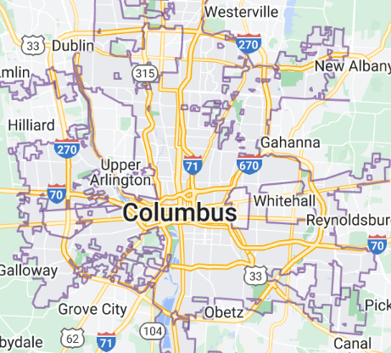

Slide 9
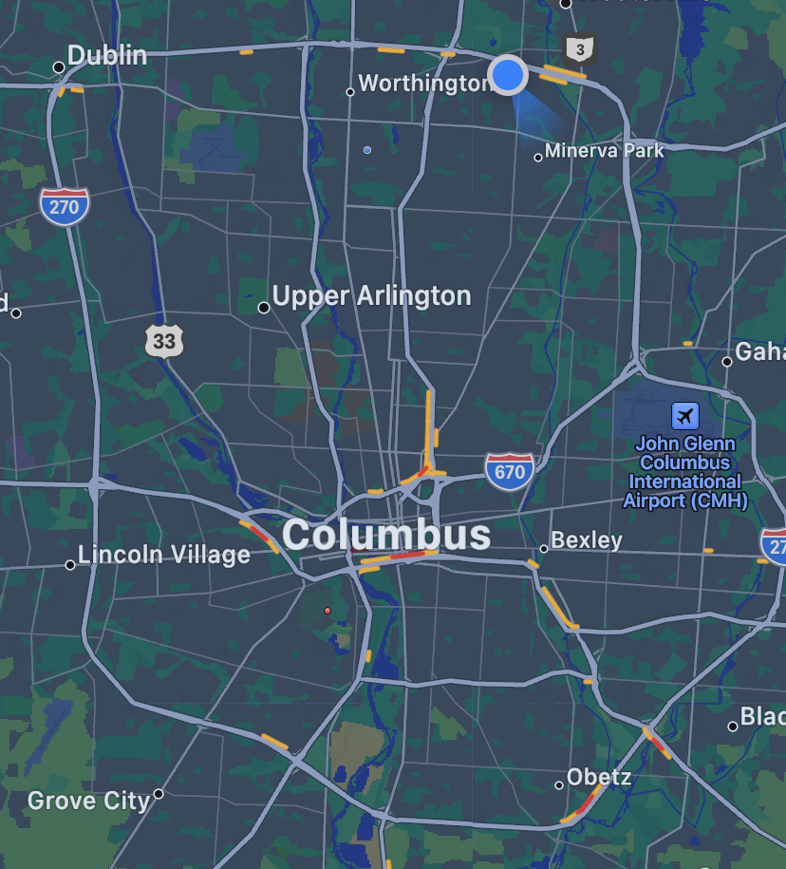

Slide 10
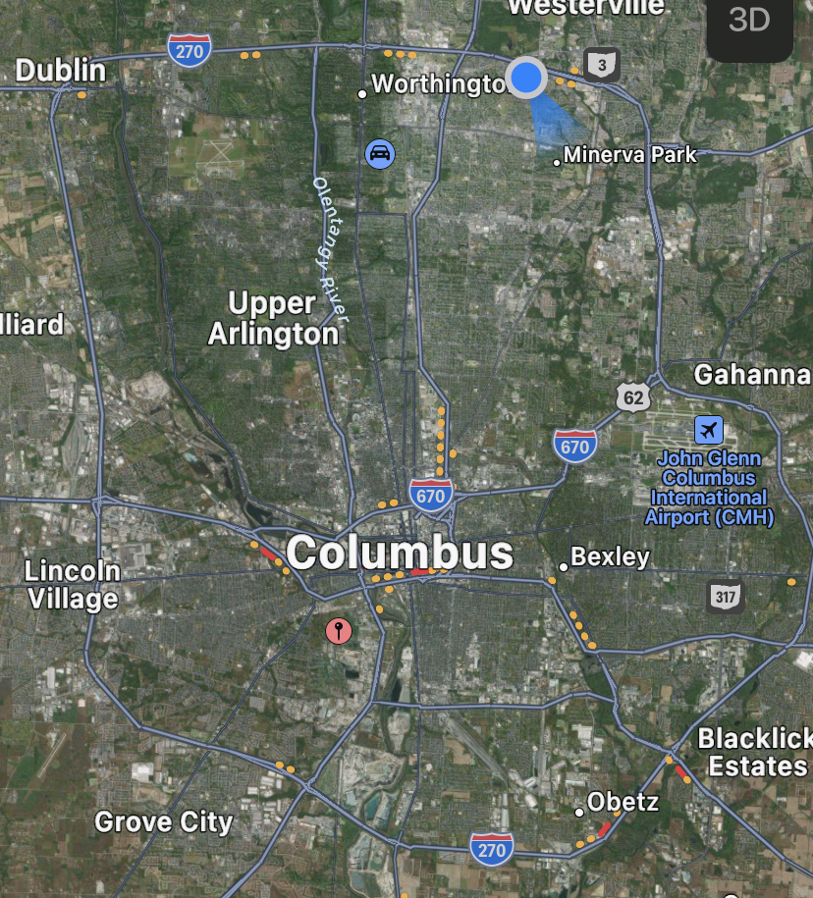

Slide 11
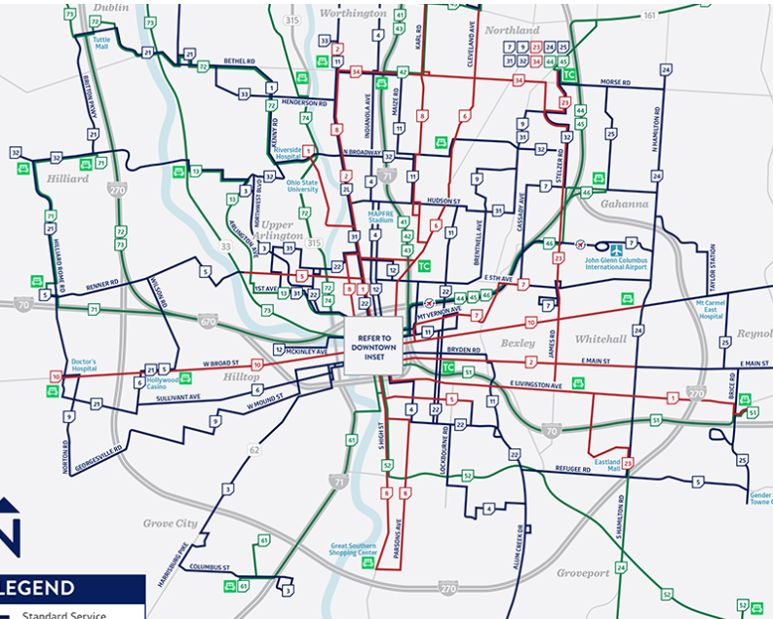

Slide 12
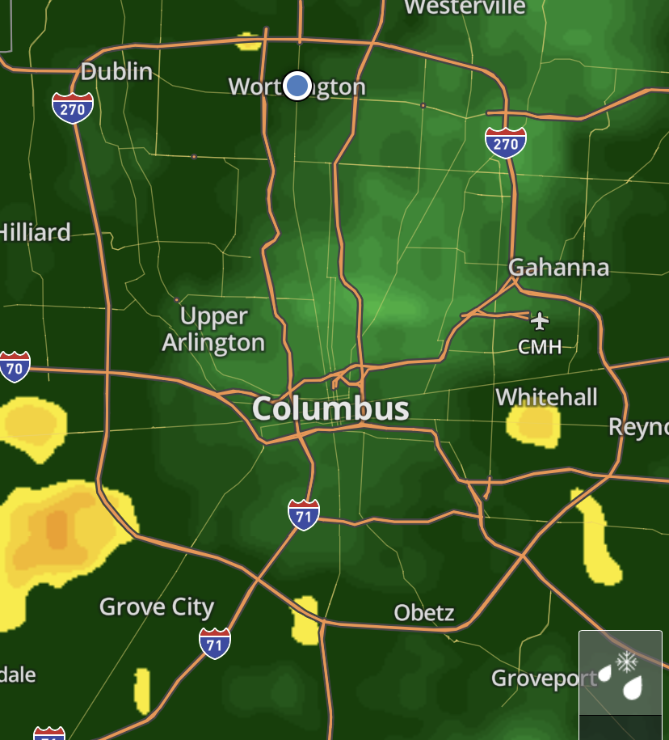

Slide 13
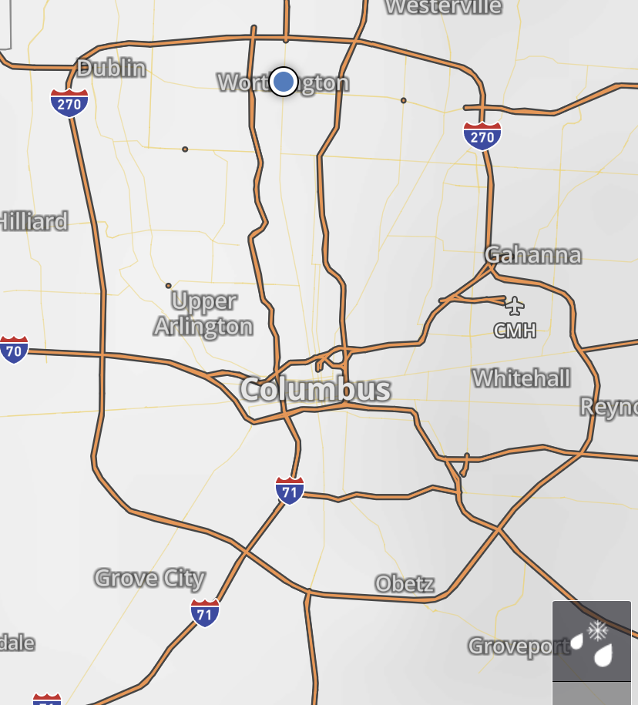

Slide 14
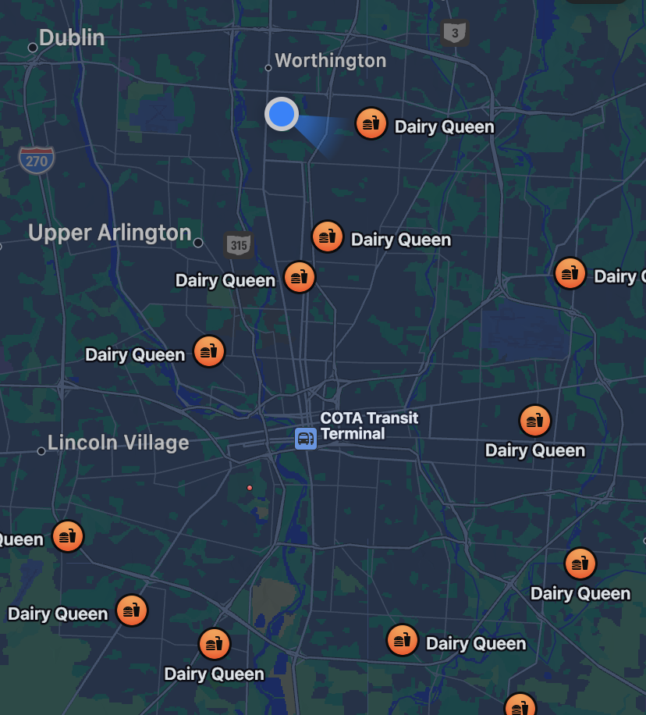

Slide 15
Set your mind on the things of the Spirit
What things?
Why?
How?
^{Romans} ^{8:5} For those who are according to the flesh set their minds on the things of the flesh, but those who are according to the Spirit, the things of the Spirit.

Slide 16
The mind set on the Spirit:
What things?
^{Romans} ^{8:5} For those who are according to the flesh set their minds on the things of the flesh, but those who are according to the Spirit, the things of the Spirit.

Slide 17
The mind set on the Spirit:
What things?
10 Times in Romans 8
21 Times in Romans 8
^{Romans} ^{8:5} For those who are according to the flesh set their minds on the things of the flesh, but those who are according to the Spirit, the things of the Spirit.

Slide 18
The mind set on the Spirit:
What things?
The “Old Self”
“New Identity In Christ”
^{Romans} ^{8:5} For those who are according to the flesh set their minds on the things of the flesh, but those who are according to the Spirit, the things of the Spirit.

Slide 19
The mind set on the Spirit:
What things?
The “Old Self”
“New Identity In Christ”
Spiritual orphans
Broken relationships
Sin nature
Under the Law
Adam
Status: “condemned”
Death
^{Romans} ^{8:5} For those who are according to the flesh set their minds on the things of the flesh, but those who are according to the Spirit, the things of the Spirit.

Slide 20
The mind set on the Spirit:
What things?
The “Old Self”
“New Identity In Christ”
Spiritual orphans
Adoption
Broken relationships
Belonging
Sin nature
Holy Spirit
Under the Law
Adam
Under Grace
Status: “condemned”
Status: “Righteous”
Death
Eternal Life
^{Romans} ^{8:5} For those who are according to the flesh set their minds on the things of the flesh, but those who are according to the Spirit, the things of the Spirit.

Slide 21
The mind set on the Spirit:
What things?
“The Flesh”
“The Spirit”
Spiritual orphans
Adoption
Broken relationships
Belonging
Sin nature
Holy Spirit
Under the Law
Adam
Under Grace
Status: “condemned”
Status: “Righteous”
Death
Eternal Life
^{Romans} ^{8:5} For those who are according to the flesh set their minds on the things of the flesh, but those who are according to the Spirit, the things of the Spirit.

Slide 22
The mind set on the Spirit:
What things?
“The Flesh”
“The Spirit”
Spiritual orphans
Adoption
Broken relationships
Belonging
Sin nature
Holy Spirit
Under the Law
Adam
Under Grace
Status: “condemned”
Status: “Righteous”
Death
Eternal Life
^{Romans 8:6} For the mind set on the flesh is death, but the mind set on the Spirit is life and peace, ⁷ because the mind set on the flesh is hostile toward God; for it does not subject itself to the law of God, for it is not even able to do so, ⁸ and those who are in the flesh cannot please God.

Slide 23
The mind set on the Spirit:
What things?
“The Flesh”
“The Spirit”
Spiritual orphans
Adoption
Broken relationships
Belonging
Sin nature
Holy Spirit
Under the Law
Adam
Under Grace
Status: “condemned”
Status: “Righteous”
Death
Eternal Life
^{Romans 8:6} For the mind set on the flesh is death, but the mind set on the Spirit is life and peace, ⁷ because the mind set on the flesh is hostile toward God; for it does not subject itself to the law of God, for it is not even able to do so, ⁸ and those who are in the flesh cannot please God.

Slide 24
The mind set on the Spirit:
What things?
“The Flesh”
“The Spirit”
Spiritual orphans
Adoption
Broken relationships
Belonging
Sin nature
Holy Spirit
Under the Law
Adam
Under Grace
Status: “condemned”
Status: “Righteous”
Death
Eternal Life
^{Romans 8:9} However, you are not in the flesh but in the Spirit, if indeed the Spirit of God dwells in you. But if anyone does not have the Spirit of Christ, he does not belong to Him.

Slide 25
The mind set on the Spirit:
What things?
“The Flesh”
“The Spirit”
Spiritual orphans
Adoption
Broken relationships
Belonging
Sin nature
Holy Spirit
Under the Law
Adam
Under Grace
Status: “condemned”
Status: “Righteous”
Death
Eternal Life
^{Romans 8:9} However, you are not in the flesh but in the Spirit, if indeed the Spirit of God dwells in you. But if anyone does not have the Spirit of Christ, he does not belong to Him.

Slide 26
The mind set on the Spirit:
What things?
“The Flesh”
“The Spirit”
Spiritual orphans
Adoption
Broken relationships
Belonging
Sin nature
Holy Spirit
Under the Law
Adam
Under Grace
Status: “condemned”
Status: “Righteous”
Death
Eternal Life
^{Romans 8:10} If Christ is in you, though the body is dead because of sin, yet the spirit is alive because of righteousness. ¹¹ But if the Spirit of Him who raised Jesus from the dead dwells in you, He who raised Christ Jesus from the dead will also give life to your mortal bodies through His Spirit who dwells in you.

Slide 27
The mind set on the Spirit:
What things?
“The Flesh”
“The Spirit”
^{Romans 7:22} I love God’s law with all my heart. ²³ But there is another power within me that is at war with my mind. This power makes me a slave to the sin that is still within me.
Spiritual orphans
Adoption
Broken relationships
Belonging
Sin nature
Holy Spirit
Under the Law
Adam
Under Grace
Status: “condemned”
Status: “Righteous”
Death
Eternal Life
^{Romans 8:10} If Christ is in you, though the body is dead because of sin, yet the spirit is alive because of righteousness. ¹¹ But if the Spirit of Him who raised Jesus from the dead dwells in you, He who raised Christ Jesus from the dead will also give life to your mortal bodies through His Spirit who dwells in you.

Slide 28
The mind set on the Spirit:
What things?
My true identity is the one that is “in Christ”…
But at any given moment, I can choose to “walk according” to the one or the other
^{Romans 8:9} However, you are not in the flesh but in the Spirit, if indeed the Spirit of God dwells in you.
^{Romans 8:4} so that the requirement of the Law might be fulfilled in us, who do not walk according to the flesh but according to the Spirit.

Slide 29
The mind set on the Spirit:
What things?
So Paul is saying if you want to walk according to the Spirit, you begin by setting your mind on the things of the Spirit instead of the things of the flesh
^{Romans 8:9} However, you are not in the flesh but in the Spirit, if indeed the Spirit of God dwells in you.
^{Romans 8:4} so that the requirement of the Law might be fulfilled in us, who do not walk according to the flesh but according to the Spirit.

Slide 30
The mind set on the Spirit:
What things?
“The Flesh”
“The Spirit”
Spiritual orphans
Adoption
Broken relationships
Belonging
Sin nature
Holy Spirit
Under the Law
Adam
Under Grace
Status: “condemned”
Status: “Righteous”
Death
Eternal Life
^{Romans 8:4} so that the requirement of the Law might be fulfilled in us, who do not walk according to the flesh but according to the Spirit.

Slide 31
The mind set on the Spirit:
What things?
^{Rom 6:11} Even so consider yourselves to be dead to sin, but alive to God
^{Rom 8:4} you also were made to die to the Law
^{Rom 6:6} our old self was crucified with Him … ⁸ we have died with Christ
^{2 Cor5:14} … one died for all, therefore all died; ¹⁵ and He died for all, so that they who live might no longer live for themselves, but for Him who died and rose again on their behalf.

Slide 32
^{Romans 7:14} For we know that the Law is spiritual, but I am of flesh, sold into bondage to sin. ¹⁵ For what I am doing, I do not understand; for I am not practicing what I would like to do, but I am doing the very thing I hate. ¹⁶ But if I do the very thing I do not want to do, I agree with the Law, confessing that the Law is good. ¹⁷ So now, no longer am I the one doing it, but sin which dwells in me.¹⁸ For I know that nothing good dwells in me, that is, in my flesh; for the willing is present in me, but the doing of the good is not. ¹⁹ For the good that I want, I do not do, but I practice the very evil that I do not want. ²⁰ But if I am doing the very thing I do not want, I am no longer the one doing it, but sin which dwells in me. ²¹ I find then the principle that evil is present in me, the one who wants to do good. ²² For I joyfully concur with the law of God in the inner man, ²³ but I see a different law in the members of my body, waging war against the law of my mind and making me a prisoner of the law of sin which is in my members. ²⁴ Wretched man that I am! Who will set me free from the body of this death?

Slide 33
^{Romans 7:14} For we know that the Law is spiritual, but I am of flesh, sold into bondage to sin. ¹⁵ For what I am doing, I do not understand; for I am not practicing what I would like to do, but I am doing the very thing I hate. ¹⁶ But if I do the very thing I do not want to do, I agree with the Law, confessing that the Law is good. ¹⁷ So now, no longer am I the one doing it, but sin which dwells in me.¹⁸ For I know that nothing good dwells in me, that is, in my flesh; for the willing is present in me, but the doing of the good is not. ¹⁹ For the good that I want, I do not do, but I practice the very evil that I do not want. ²⁰ But if I am doing the very thing I do not want, I am no longer the one doing it, but sin which dwells in me. ²¹ I find then the principle that evil is present in me, the one who wants to do good. ²² For I joyfully concur with the law of God in the inner man, ²³ but I see a different law in the members of my body, waging war against the law of my mind and making me a prisoner of the law of sin which is in my members. ²⁴ Wretched man that I am! Who will set me free from the body of this death?

Slide 34
^{Romans 7:14} For we know that the Law is spiritual, but I am of flesh, sold into bondage to sin. ¹⁵ For what I am doing, I do not understand; for I am not practicing what I would like to do, but I am doing the very thing I hate. ¹⁶ But if I do the very thing I do not want to do, I agree with the Law, confessing that the Law is good. ¹⁷ So now, no longer am I the one doing it, but sin which dwells in me.¹⁸ For I know that nothing good dwells in me, that is, in my flesh; for the willing is present in me, but the doing of the good is not. ¹⁹ For the good that I want, I do not do, but I practice the very evil that I do not want. ²⁰ But if I am doing the very thing I do not want, I am no longer the one doing it, but sin which dwells in me. ²¹ I find then the principle that evil is present in me, the one who wants to do good. ²² For I joyfully concur with the law of God in the inner man, ²³ but I see a different law in the members of my body, waging war against the law of my mind and making me a prisoner of the law of sin which is in my members. ²⁴ Wretched man that I am! Who will set me free from the body of this death?

Slide 35
^{Romans 7:14} For we know that the Law is spiritual, but I am of flesh, sold into bondage to sin. ¹⁵ For what I am doing, I do not understand; for I am not practicing what I would like to do, but I am doing the very thing I hate. ¹⁶ But if I do the very thing I do not want to do, I agree with the Law, confessing that the Law is good. ¹⁷ So now, no longer am I the one doing it, but sin which dwells in me.¹⁸ For I know that nothing good dwells in me, that is, in my flesh; for the willing is present in me, but the doing of the good is not. ¹⁹ For the good that I want, I do not do, but I practice the very evil that I do not want. ²⁰ But if I am doing the very thing I do not want, I am no longer the one doing it, but sin which dwells in me. ²¹ I find then the principle that evil is present in me, the one who wants to do good. ²² For I joyfully concur with the law of God in the inner man, ²³ but I see a different law in the members of my body, waging war against the law of my mind and making me a prisoner of the law of sin which is in my members. ²⁴ Wretched man that I am! Who will set me free from the body of this death?

Slide 36
The “things of the flesh”
sin focus
^{Gal 6:14} the world has been crucified to me, and I to the world.
law focus
^{1 John 2:17} The world is passing away, and also its lusts…
self focus
world focus

Slide 37
The “things of the flesh”
sin focus
law focus
self focus
world focus
^{Rom 8:5} For those who are according to the flesh set their minds on the things of the flesh, but those who are according to the Spirit, the things of the Spirit.

Slide 38
The “things of the flesh”
sin focus
law focus
self focus
world focus
^{Rom 8:5} For those who are according to the flesh set their minds on the things of the flesh, but those who are according to the Spirit, the things of the Spirit.

Slide 39
The “things of the flesh”
The “things of the Spirit”
sin focus
new identity in Christ focus
law focus
self focus
world focus
^{Rom 8:5} For those who are according to the flesh set their minds on the things of the flesh, but those who are according to the Spirit, the things of the Spirit.

Slide 40
The “things of the flesh”
The “things of the Spirit”
sin focus
new identity in Christ focus
law focus
grace focus
self focus
^{Rom 6:14} For sin shall not be master over you, for you are not under law but under grace.
world focus
We should dwell on these things!
^{Rom 8:5} For those who are according to the flesh set their minds on the things of the flesh, but those who are according to the Spirit, the things of the Spirit.

Slide 41
The “things of the flesh”
The “things of the Spirit”
sin focus
new identity in Christ focus
law focus
grace focus
self focus
How much of your mental bandwidth is devoted to yourself?
world focus
^{Rom 8:5} For those who are according to the flesh set their minds on the things of the flesh, but those who are according to the Spirit, the things of the Spirit.

Slide 42
The “things of the flesh”
The “things of the Spirit”
sin focus
new identity in Christ focus
law focus
grace focus
self focus
others focus
But in Christ we have an inexhaustible source of love, security, meaning… which frees us!
world focus
^{Rom 8:5} For those who are according to the flesh set their minds on the things of the flesh, but those who are according to the Spirit, the things of the Spirit.

Slide 43
The “things of the flesh”
The “things of the Spirit”
sin focus
new identity in Christ focus
law focus
grace focus
self focus
Others focus
world focus
^{Rom 8:5} For those who are according to the flesh set their minds on the things of the flesh, but those who are according to the Spirit, the things of the Spirit.

Slide 44
The “things of the flesh”
The “things of the Spirit”
sin focus
new identity in Christ focus
law focus
grace focus
self focus
Others focus
^{Colossians 3:3} For you have died and your life is hidden with Christ in God.
world focus
^{Rom 8:5} For those who are according to the flesh set their minds on the things of the flesh, but those who are according to the Spirit, the things of the Spirit.

Slide 45
The “things of the flesh”
The “things of the Spirit”
sin focus
new identity in Christ focus
law focus
grace focus
self focus
others focus
This is often the key to escaping our mudpuddle!
world focus
^{Rom 8:5} For those who are according to the flesh set their minds on the things of the flesh, but those who are according to the Spirit, the things of the Spirit.

Slide 46
The “things of the flesh”
The “things of the Spirit”
sin focus
new identity in Christ focus
law focus
grace focus
self focus
others focus
“How can I get what I want from the world around me?”
world focus
^{Rom 8:5} For those who are according to the flesh set their minds on the things of the flesh, but those who are according to the Spirit, the things of the Spirit.

Slide 47
The “things of the flesh”
The “things of the Spirit”
sin focus
new identity in Christ focus
law focus
grace focus
^{Colossians 3:1} Therefore if you have been raised up with Christ, keep seeking the things above, where Christ is, seated at the right hand of God. ² Set your mind on the things above, not on the things that are on earth. ³ For you have died and your life is hidden with Christ in God. ⁴ When Christ, who is our life, is revealed, then you also will be revealed with Him in glory.
self focus
Others focus
world focus
^{Rom 8:5} For those who are according to the flesh set their minds on the things of the flesh, but those who are according to the Spirit, the things of the Spirit.

Slide 48
The “things of the flesh”
The “things of the Spirit”
sin focus
new identity in Christ focus
law focus
grace focus
self focus
others focus
eternity future focus
world focus
^{Rom 8:5} For those who are according to the flesh set their minds on the things of the flesh, but those who are according to the Spirit, the things of the Spirit.

Slide 49
How different is the experience of daily life between these mindsets?
The “things of the flesh”
The “things of the Spirit”
sin focus
new identity in Christ focus
law focus
grace focus
self focus
others focus
eternity future focus
world focus
^{Rom 8:5} For those who are according to the flesh set their minds on the things of the flesh, but those who are according to the Spirit, the things of the Spirit.

Slide 50
The mind set on the Spirit:
Why?
^{Rom 8:5} For those who are according to the flesh set their minds on the things of the flesh, but those who are according to the Spirit, the things of the Spirit.

Slide 51
The mind set on the Spirit:
Why?
And that’s important because I think our instinct is to do exactly that!
^{Rom 8:6} For the mind set on the flesh is death, but the mind set on the Spirit is life and peace, ⁷ because the mind set on the flesh is hostile toward God; for it does not subject itself to the law of God, for it is not even able to do so, ⁸ and those who are in the flesh cannot please God.

Slide 52
The “things of the flesh”
sin focus
The “religious” approach to personal growth
law focus
self focus
world focus
toward God; for it does not subject itself to the law of God, for it is not even able to do so, ⁸ and those who are in the flesh cannot please God.

Slide 53
The “things of the flesh”
sin focus
The “religious” approach to personal growth
law focus
self focus
world focus
^{Rom 8:6} For the mind set on the flesh is death, but the mind set on the Spirit is life and peace, ⁷ because the mind set on the flesh is hostile toward God; for it does not subject itself to the law of God, for it is not even able to do so, ⁸ and those who are in the flesh cannot please God.

Slide 54
The “things of the flesh”
sin focus
The “religious” approach to personal growth
law focus
self focus
The “secular” approach to personal growth
world focus
“If I want to grow personally, what should I think about?”

Slide 55
The “things of the flesh”
sin focus
The “religious” approach to personal growth
law focus
self focus
The “secular” approach to personal growth
world focus
Focus on your sense of self, focus on the experiences and things you want to have, and you will be happy.

Slide 56
The “things of the flesh”
sin focus
The “religious” approach to personal growth
law focus
self focus
The “secular” approach to personal growth
world focus
Look within to discover meaning, and look without to find validation and resources to shape reality to be what you want

Slide 57
The “things of the flesh”
And how’s it going?
sin focus
The “religious” approach to personal growth
law focus
self focus
The “secular” approach to personal growth
world focus
Our culture actively promotes focusing on self and getting what you want as the answer to mental health personal wellbeing!

Slide 58
The “things of the flesh”
sin focus
law focus
self focus
A skewed filter that gives a distorted picture…
world focus
^{Rom 8:6} For the mind set on the flesh is death, but the mind set on the Spirit is life and peace

Slide 59
The “things of the Spirit”
Factoring the things of God into our mindset makes for a much better way to live!
new identity in Christ focus
grace focus
Even if it doesn’t seem like it would…
Others focus
eternity future focus
^{Rom 8:6} For the mind set on the flesh is death, but the mind set on the Spirit is life and peace

Slide 60
The “things of the Spirit”
new identity in Christ focus
We get a choice …
grace focus
Others focus
eternity future focus
^{Rom 8:6} For the mind set on the flesh is death, but the mind set on the Spirit is life and peace
^{Rom 8:6} For the mind set on the flesh is death, but the mind set on the Spirit is life and peace

Slide 61
The mind set on the Spirit:
Why?
This is your part in “walking according to the Spirit”
You have the ability to “set your mind!”
^{Rom 8:6} For the mind set on the flesh is death, but the mind set on the Spirit is life and peace

Slide 62
The mind set on the Spirit:
How?
Notice what you are thinking about
Thought experiment:
What have you been thinking about so far today?
^{Rom 8:6} For the mind set on the flesh is death, but the mind set on the Spirit is life and peace

Slide 63
The mind set on the Spirit:
How?
Notice what you are thinking about
Take your thoughts captive
^{2Cor 10:5} We are destroying speculations and every lofty thing raised up against the knowledge of God, and we are taking every thought captive to the obedience of Christ
Not only do we have the power to notice what we are thinking about, we have the power to critique what we are thinking!
^{Rom 8:6} For the mind set on the flesh is death, but the mind set on the Spirit is life and peace

Slide 64
The mind set on the Spirit:
How?
Notice what you are thinking about
Take your thoughts captive
^{2Cor 10:5} We are destroying speculations and every lofty thing raised up against the knowledge of God, and we are taking every thought captive to the obedience of Christ
Learn to preach to yourself
^{Rom 8:6} For the mind set on the flesh is death, but the mind set on the Spirit is life and peace

Slide 65
The mind set on the Spirit:
How?
Notice what you are thinking about
Take your thoughts captive
Meditate on God’s Word
^{Rom 8:6} For the mind set on the flesh is death, but the mind set on the Spirit is life and peace

Slide 66
The mind set on the Spirit:
How?
Notice what you are thinking about
Take your thoughts captive
Meditate on God’s Word
Invite God into your thinking
Gratitude is probably the single best shortcut I know for switching your mindset from flesh to spirit
^{Rom 8:6} For the mind set on the flesh is death, but the mind set on the Spirit is life and peace

Slide 67
The mind set on the Spirit:
How?
Notice what you are thinking about
Take your thoughts captive
Meditate on God’s Word
Invite God into your thinking
Invite other Christians into your thinking
^{Rom 8:6} For the mind set on the flesh is death, but the mind set on the Spirit is life and peace

Slide 68
The mind set on the Spirit:
How?
Notice what you are thinking about
Take your thoughts captive
Meditate on God’s Word
Invite God into your thinking
Invite other Christians into your thinking
Get involved in serving other people
This displaces the mind set on the self
^{Rom 8:6} For the mind set on the flesh is death, but the mind set on the Spirit is life and peace

Slide 69
R O M A N S
Setting your mind on the things of the Spirit is a step of faith… but because of the Spirit who lives in us, it always delivers!

Slide 70
R O M A N S
Next Week…

